Slide 1
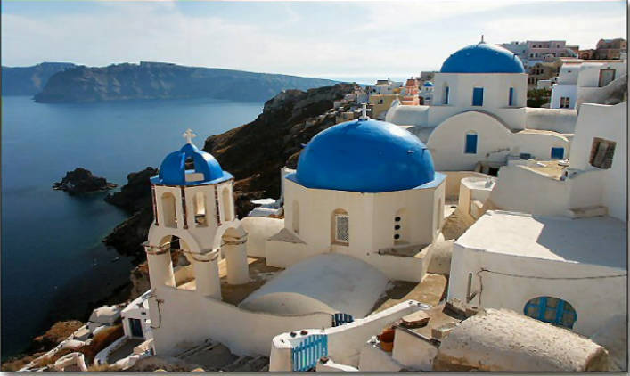
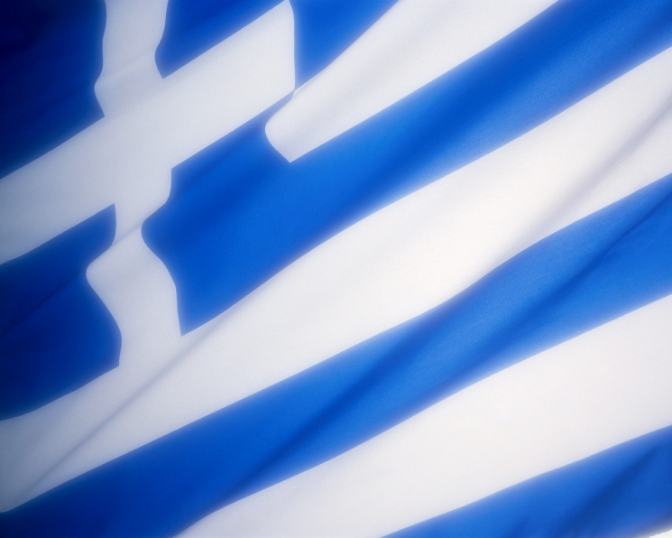
Greece

Slide 2
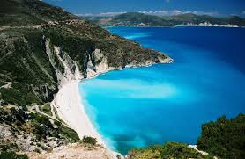
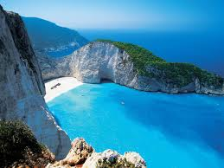
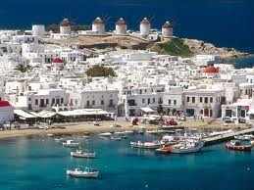
Greece
Population for Greece is 11,319,048.Greece has 131,800km².

Slide 3
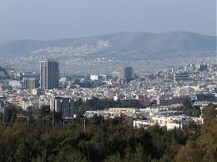
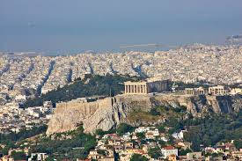
Athens
Athens is the capital city of Greece .
Area: 412 km²
Population: 789,166(2001)

Slide 4
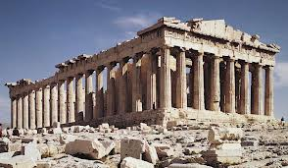
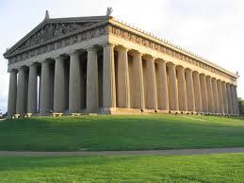
Parthenon
The Parthenon is a temple on the Athenian Acropolis.It is 14 m high .Parthenon is 3000 years old and it is the oldest building in Greece.

Slide 5
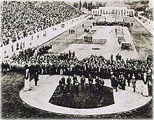
Olympics
The first Olympics games were in Greece on Summer 1896.

Slide 6
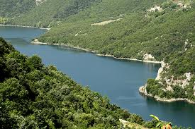
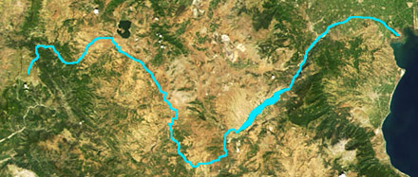
Longest River
The longest river in Greece is Aliakmon.It is 320 km long.

Slide 7
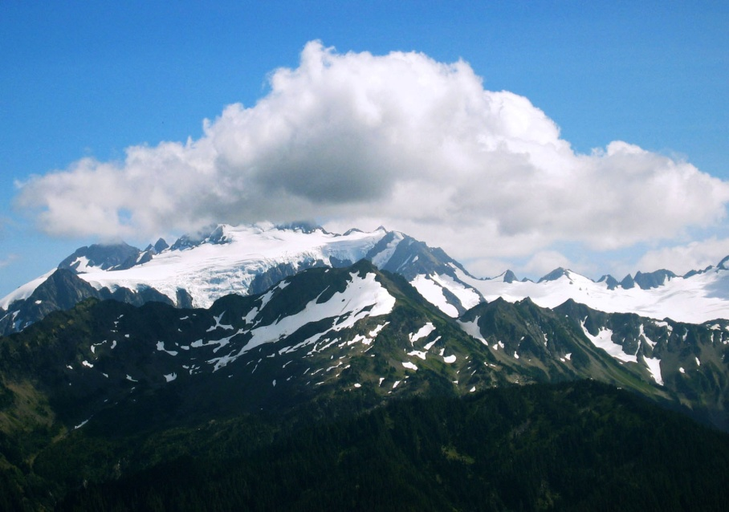
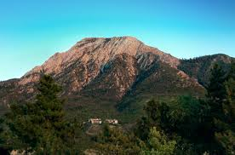
Highest Mountain
The highest mountain in Greece is Mount Olympus.It is 2,917 m high.

Slide 8
Made by:Ena Domazet
7th Grade

