Slide 1
Poland

Slide 2
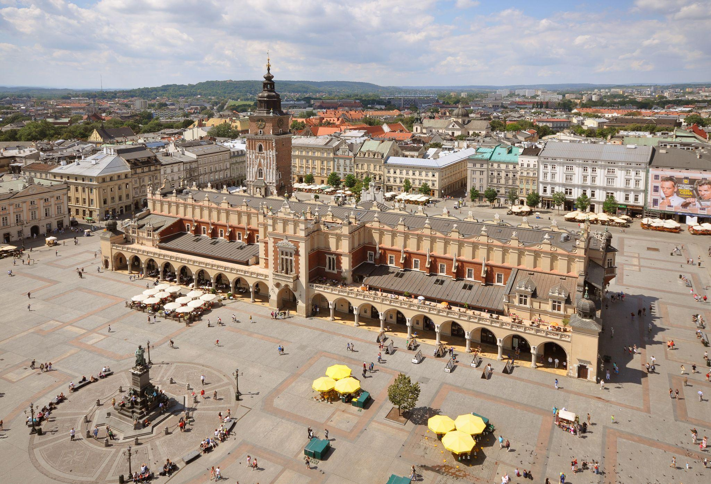
CRACOW
Cracow is city in South Poland.
The main square of the Old Town of Cracow
Located on the Royal Road
Designed in 1257.

Slide 3
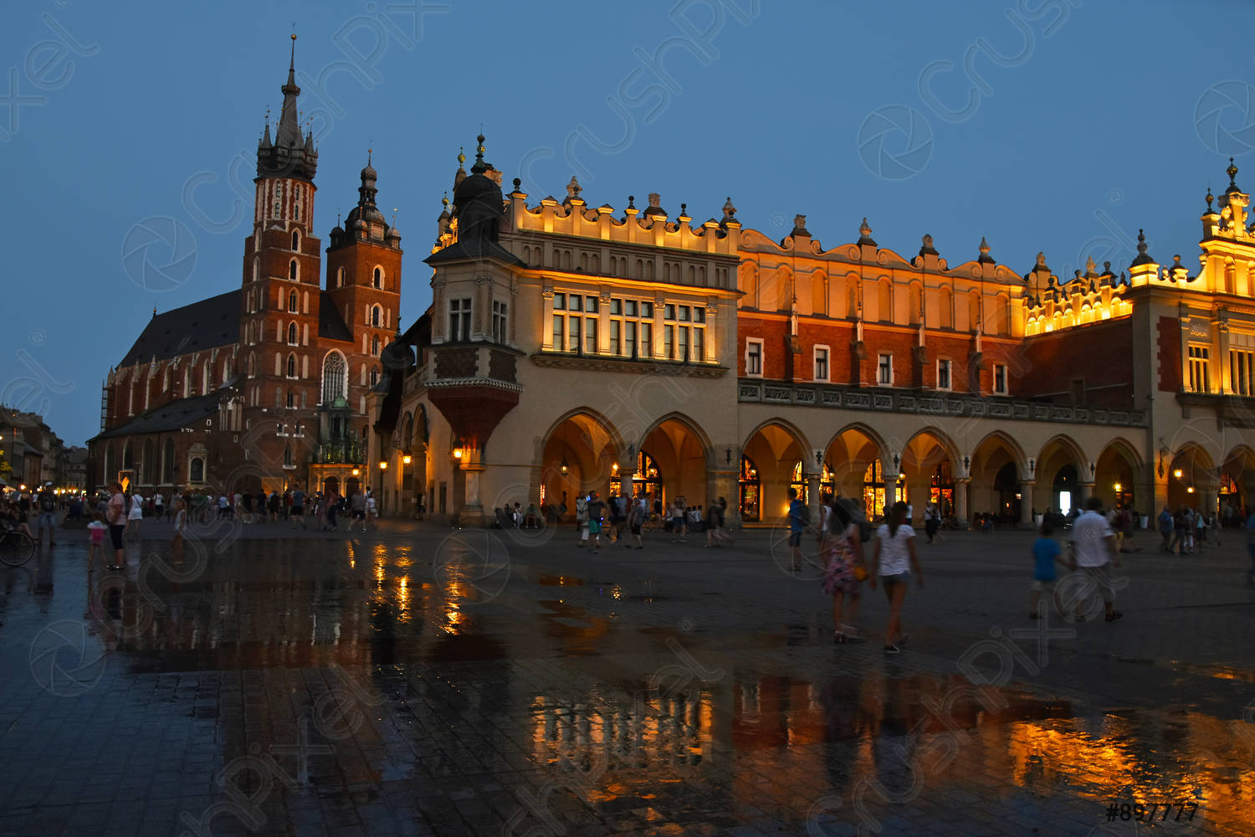
13 th century
Rynek Glowny
400000 square meters
327 km2
Open public space

Slide 4
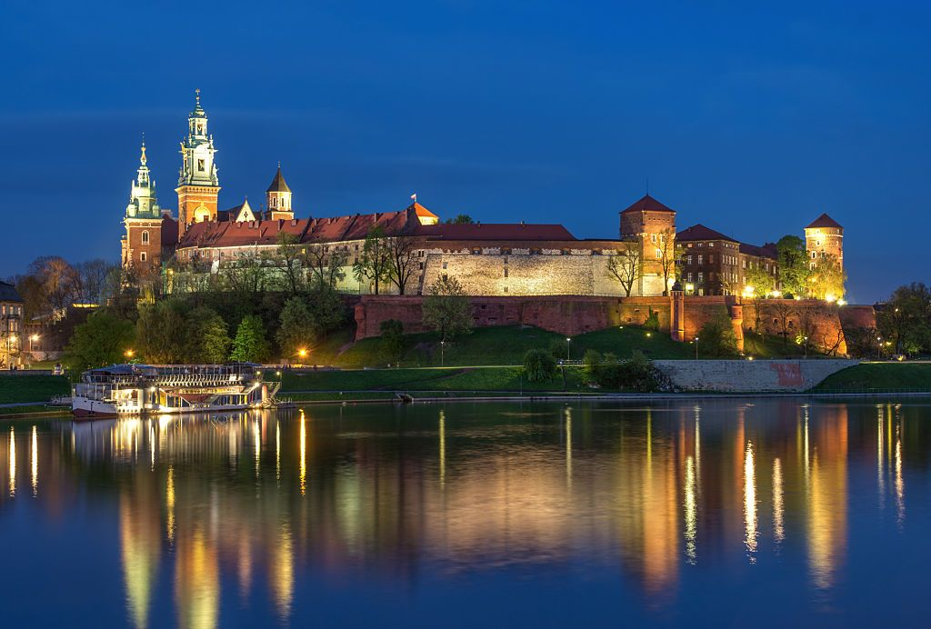
The Wawel Royal Castle
Slavic people
7040 m2
Residence of Polish kings for centuries

Slide 5
Gardens and walls
Architectural style(s) are Romanesque, gothic, Renaissance
2100 000 visitors
Residence of Polish kings for centuries

Slide 6
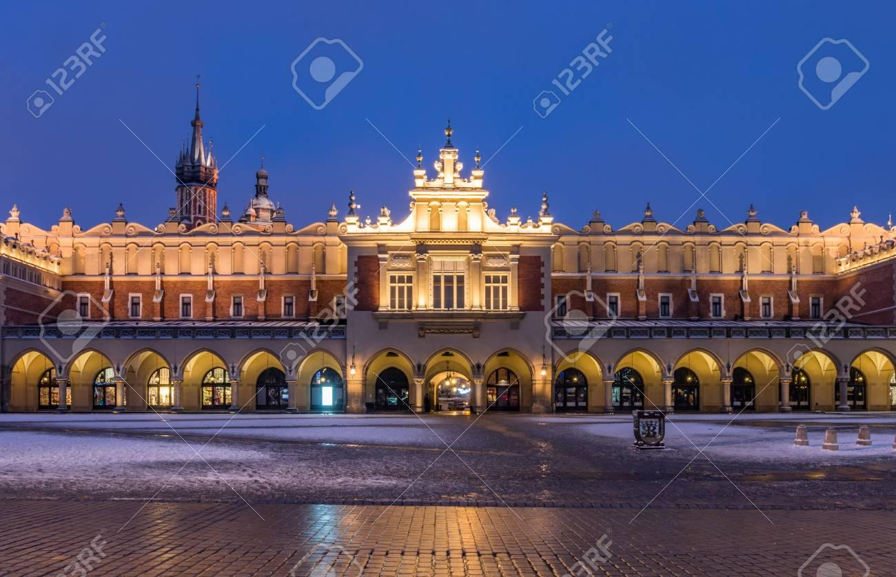
The Cloth Hall in Cracow
Capital city
Central feature of the main market square
Architect Tomasz Prylinski

Slide 7
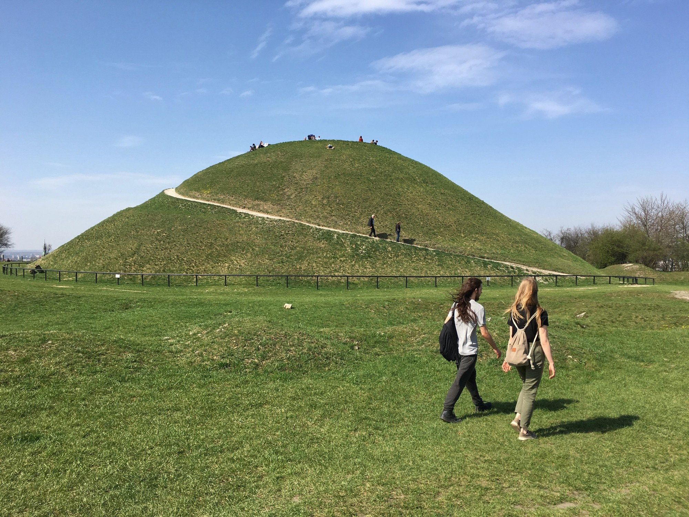
Krakus Mound
Also called the Krak Mound
Tumulus located in the Podgorze
16 metres

Slide 8
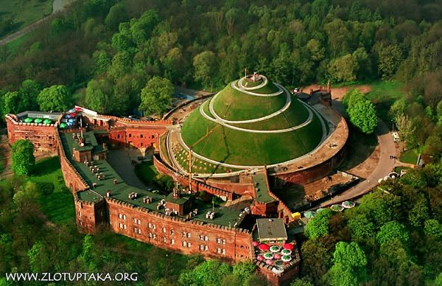
Kosciuszko Mound
Artifical mound
In November 1823.
34 metres

Slide 9
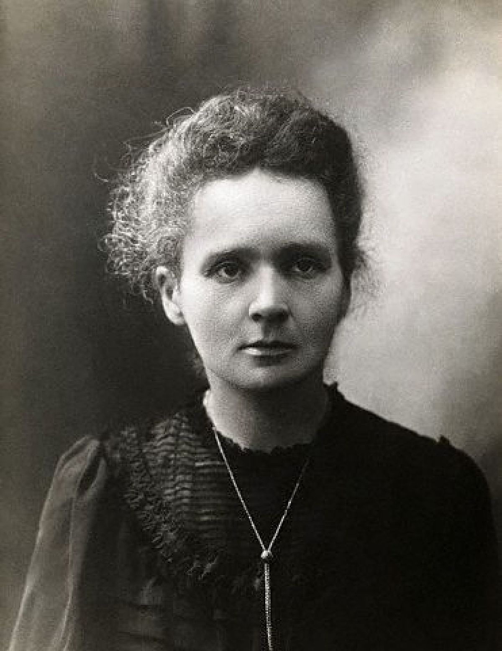
MARIE SKLODOWSKA CURIE
Born in Warsaw in Poland 7 November 1867.
Polish-born French physicst
Died on 4 July 1934.

Slide 10
GOLABKI
Ingredients
1 head cabbage, cored
2 tablespoons butter
1 large onion, chopped
½ pound ground pork
1 ½ cups cooked rice
1 teaspoon finely chopped garlic
1 teaspoon salt, plus more to taste
¼ teaspoon ground black pepper, plus more to taste
3 ( 10.75 ounce) cans condensed tomato soup
2 ( 12 fluid once) cans tomato juice, or more to taste
½ cup ketchup

Slide 11
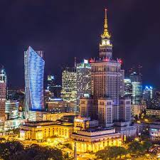
WARSAW

Slide 12
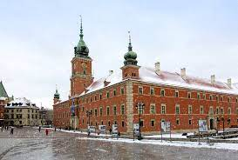
Warsaw is called the city of
the phoenix.
Warsaw has been the capital
since 1596. until now.

Slide 13
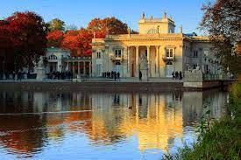
Symbol of the city, the Warsaw Mermaid.
It was bombed by the Germans in
1939. during Word War II.

Slide 14
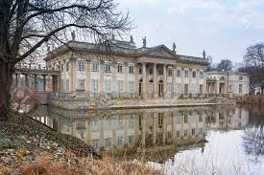
The oldest city park is
the royal spa from the
17th century.
The longest street in
Warsaw is Pulawska
Street - 10 km.

Slide 15
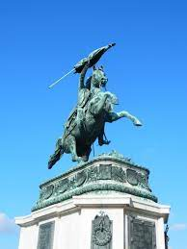
The presidential palace
and the Polish government
are located in Warsaw.
Warsaw is the largest
university center in Poland.

Slide 16
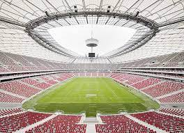
The 2012 European Football
Championship kicked off with
a football match in Warsaw.
There are many art museums
and galleries in Warsaw, both
public and private.

Slide 17
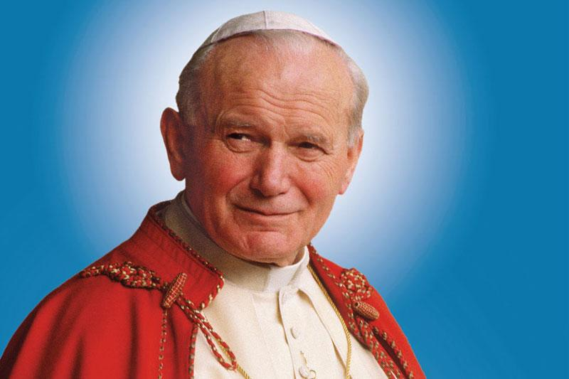
Ivan Pavao II.
Births : May 18, 1920
Died: April 2, 2005
He promoted interreligious dialogue and peace.

Slide 18
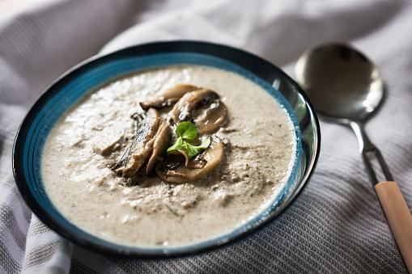
MUSHROOM SOUP
500 g of mushrooms
1 onion
2 garlic cloves
200 ml bijelog vina
200 ml of sour cream
90g butter and oil
parsley
1 carrot
sol, paper
Water 1.5l

Slide 19
Wroclaw
Build across several islands
People 638 659
The European capital city of culture in 2016
They call it the city of these mass structures

Slide 20
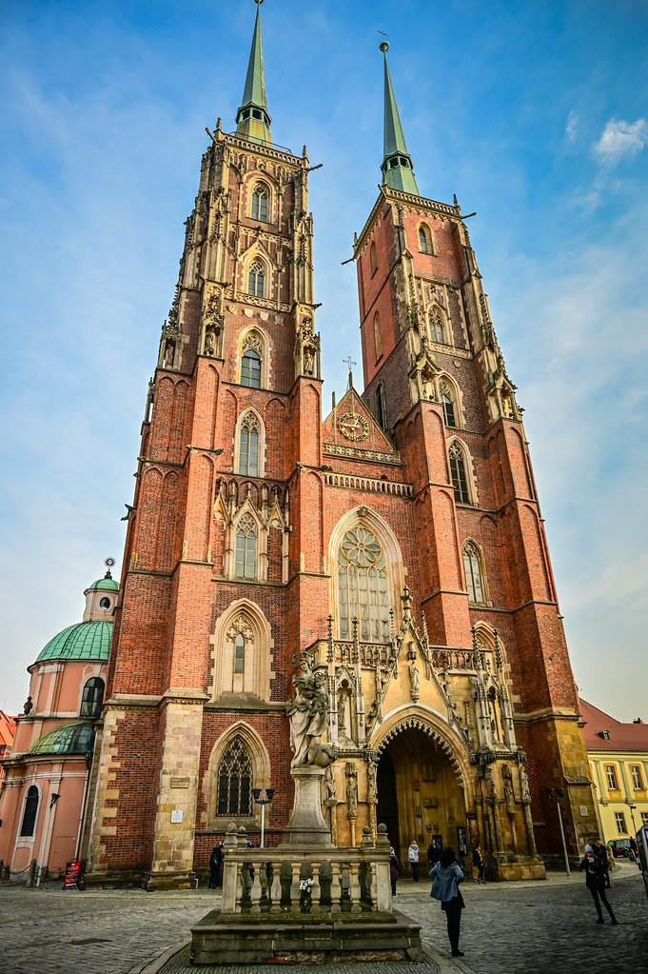
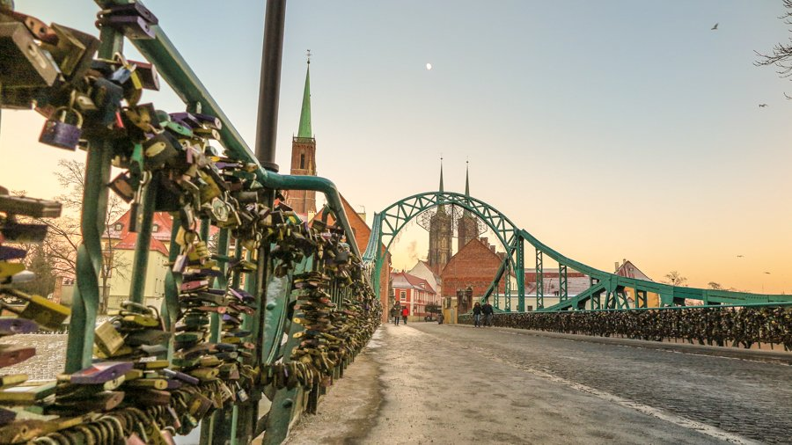
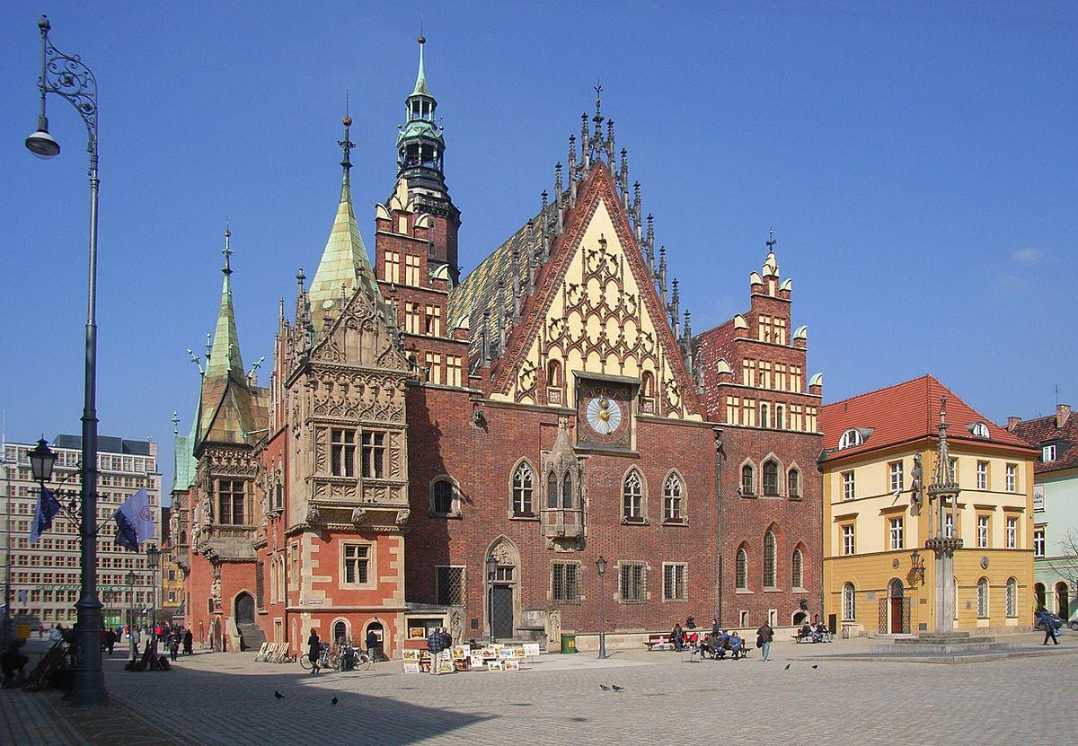
Museum of Bourgeois art
Cathedral of St. John the Baptist
Newlyweds symbolically seal their love by putting padlocks

Slide 21
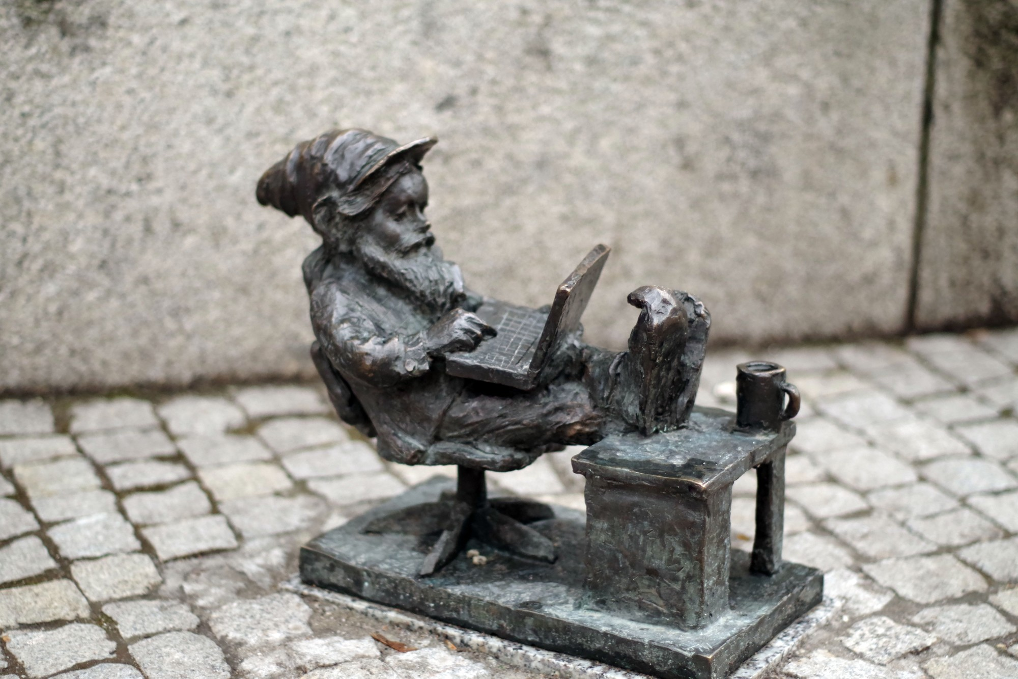
City of even 250 dwarves
Some of them ‘’live’’ in public places, while others are hidden
Each has its own story

Slide 22
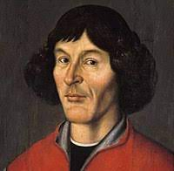
Mikolaj Kopernik
Born February 19, 1473
Gave a simple system: the Earth and the planets move uniformly in circles, at the center of which is the Sun
Died May 24, 1543

Slide 23
Pierogi - Ingredients
Dough - 500g of smooth flour And more - 10 dag of bacon
200 ml of water sour cream
spoon of oil
1 egg
a pinch of salt
Meat filling - 250g mixed minced meat
1 onion
1 clove of garlic
salt, pepper, parsley
1 tablespoon of butter

